Slide 1


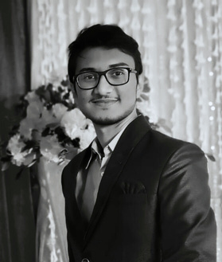
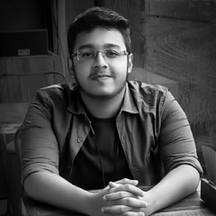
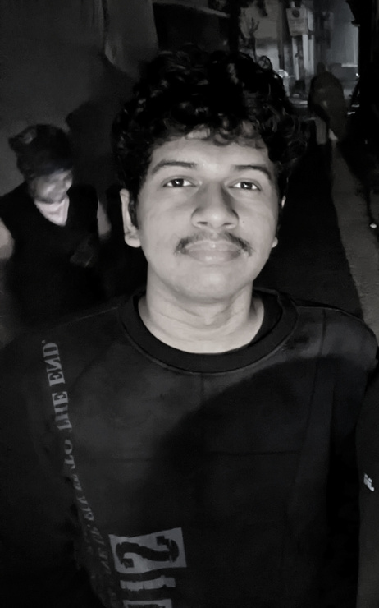
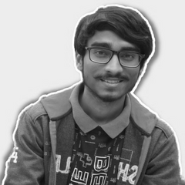
Priyobroto Acharya
Power Engineering, Jadavpur University
HACK FORGE PRESENTATION
Shreyaan Saha
Power Engineering, Jadavpur University
Team ByteBandits present
Tirtha Biswas
BetterME
Power Engineering, Jadavpur University
A one-stop healthcare solution for India
Udbhas Dutta
Power Engineering, Jadavpur University

Slide 2


PROBLEM THEME
Healthcare Innovation: Identify the challenges and obstacles in the healthcare sector. Create an innovative application that deals with these challenges and helps individuals to maintain or boost their physical well-being. Example: This app can include features such as workout planners, nutrition tracking, or telemedicine platform connecting patients and doctors for remote consultations etc.
OUR VISION
Our team's vision is to help people achieve their best health. We want to create a future where healthcare is easy to use and personalized for everyone. Through our web app, we aim to provide a one-stop solution for various healthcare needs. We also aim to build a supportive community, changing the way people take care of their health.

Slide 3
5.8 MILLION
Indians die because of diabetes, cancer, stroke, heart and lung diseases each year
52 PERCENT
Indian's resort to intake of unprescribed medicine according to their will
7 OUT OF 10
Indian gym members don't subscribe to a personal trainer

Slide 4


Derived from the common human nature, we like advises from only those who know more than us. If someone keeps telling us all those things that we already know, it delivers no value.
Based on this we’re providing a holistic healthcare hub with self-diagnosis, personalized plans, and seamless doctor-patient communication for a comprehensive user experience.
Now no intake of unprescribed medicine and no exercise without expert training consultation. We have got your back.
We look forward to making our app the one stop healthcare solution for India.
IMPACT OF OUR SOLUTION
BetterME

Slide 5
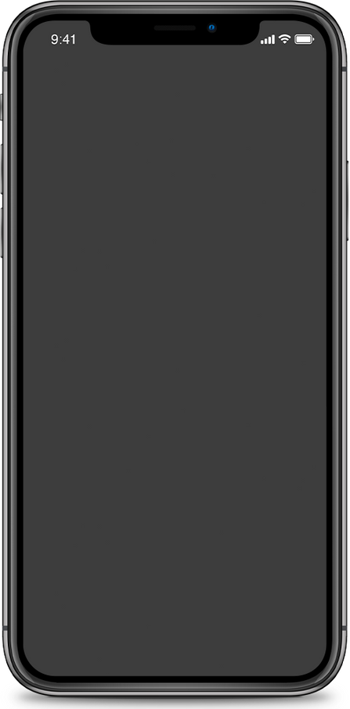
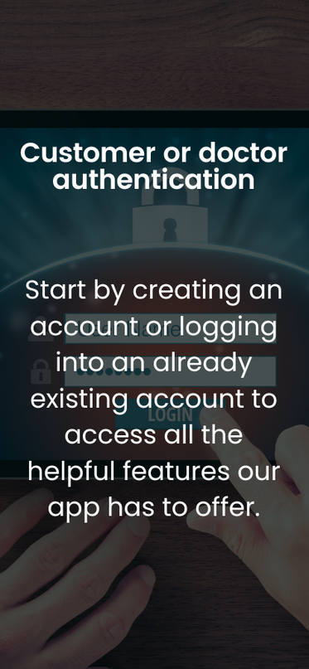

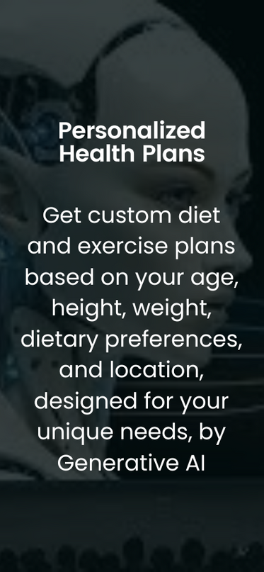
FEATURES OF
BetterME

Slide 6


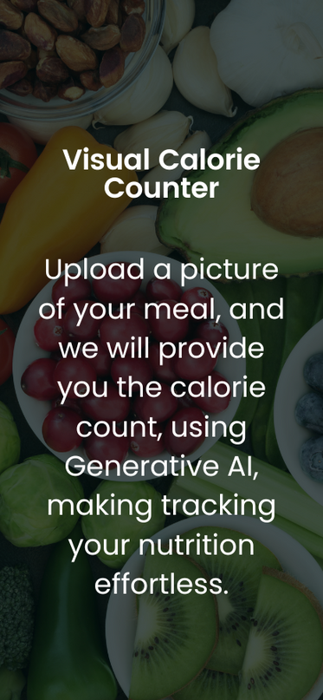
FEATURES OF
BetterME

Slide 7

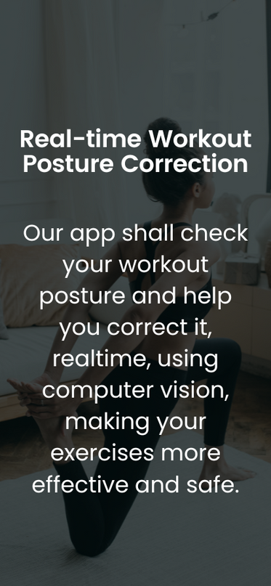

FEATURES OF
BetterME

Slide 8
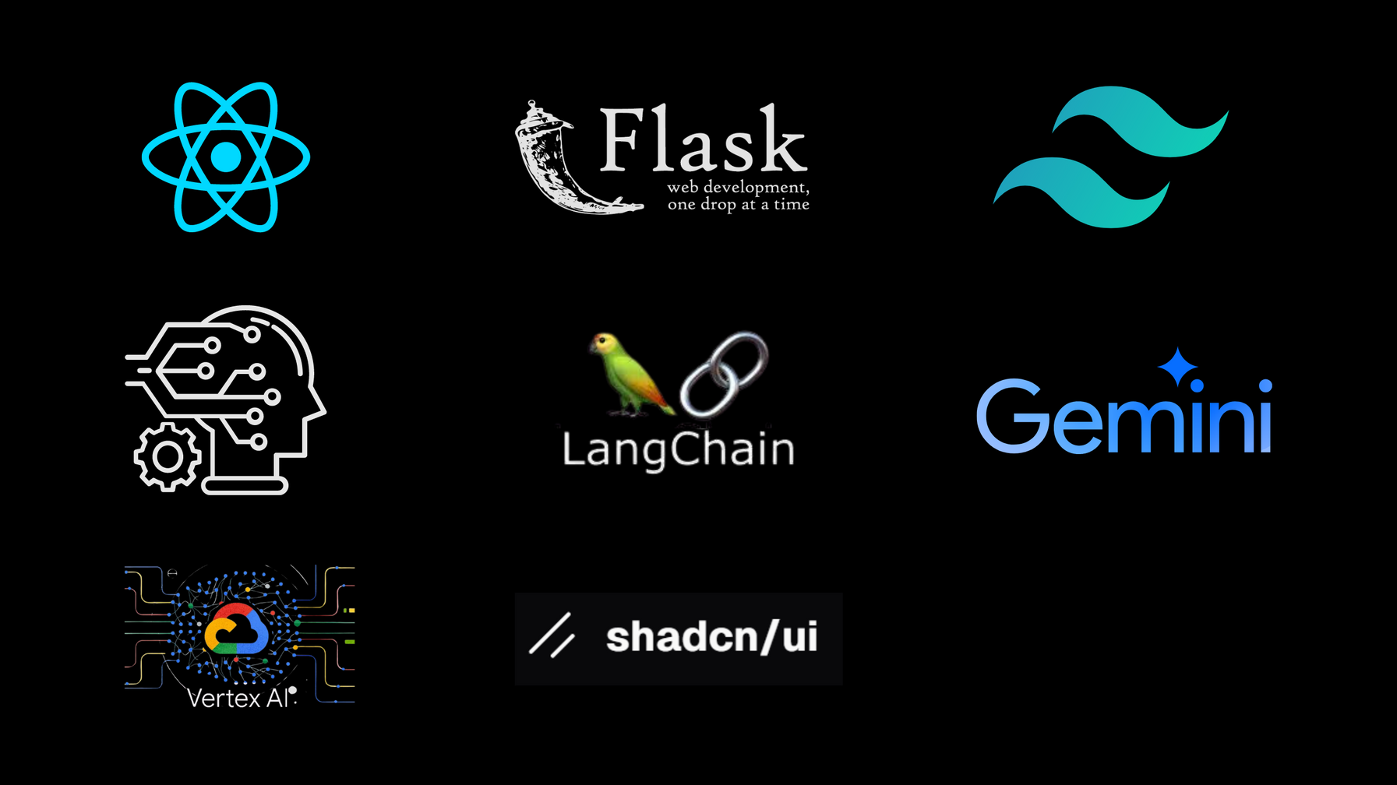
TECH STACK
we shall use while building the product
React
Flask
Tailwind CSS
Machine Learning
Langchain
Generative AI
Vertex AI
ShadCN

Slide 9
THANK YOU!
for giving us this opportunity and hope you like our work

